Slide 1
PlanManager Training
Sue Allwood
October 2015

Slide 2
PlanManager Training Topics
Welcome and Introductions
What is PlanManager
Roll Out
Accessing PlanManager
URL
Functionality
User Registration
Terms and Conditions
Login
Plan Selection
WGAG 2.0 AA Standards
Dash Reports
Contacts
Message Centre
Quick Links
Plan Information and Documents
Member Search
Report Manager
What is a Role?
What is a Scope?
What is a Filter?
What is a Direct Report
My Reports
Request Reports
Manage Reports
Manage Scopes
Manage Filters
List of Reports
Workforce Manager
Contribution Manager
Branding and Content Management
Forgotten UserID
Forgotten Password
Web User Activity

Slide 3
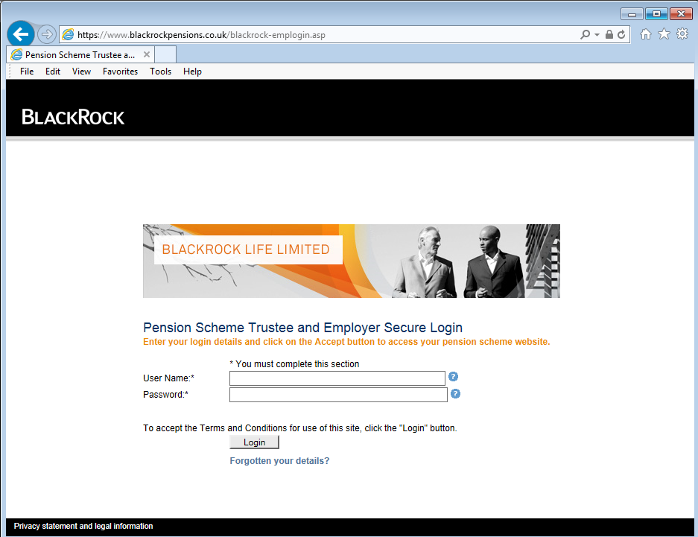
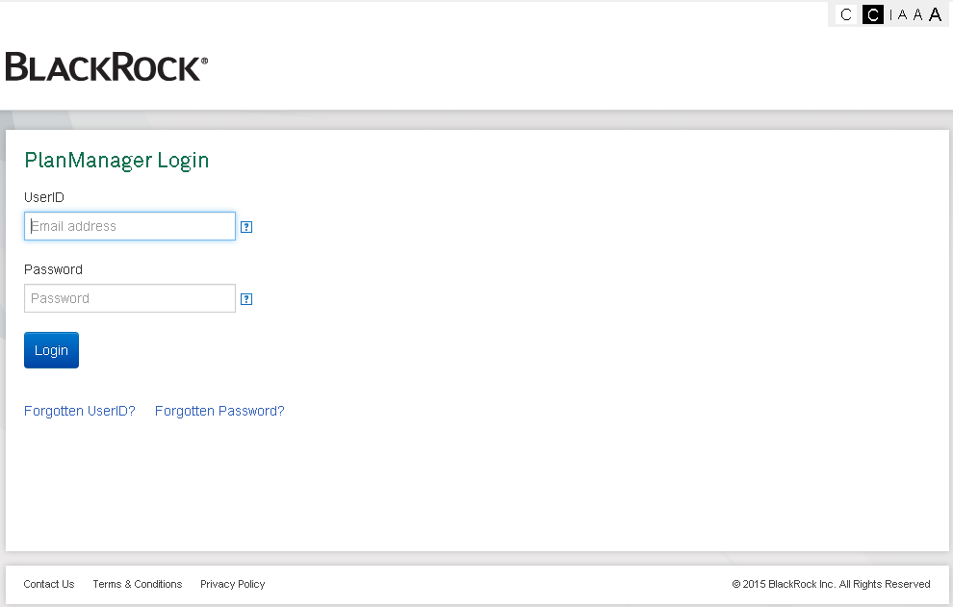
What is PlanManager?
PlanManager is the replacement for Group Web

Slide 4
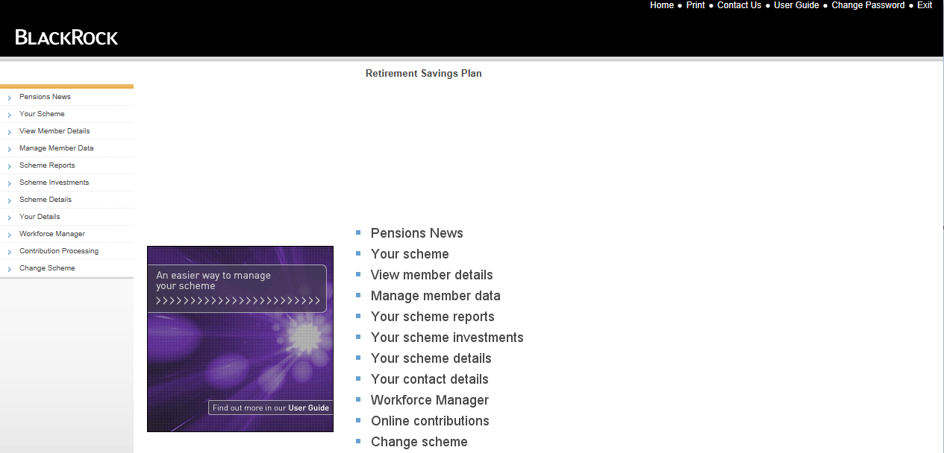
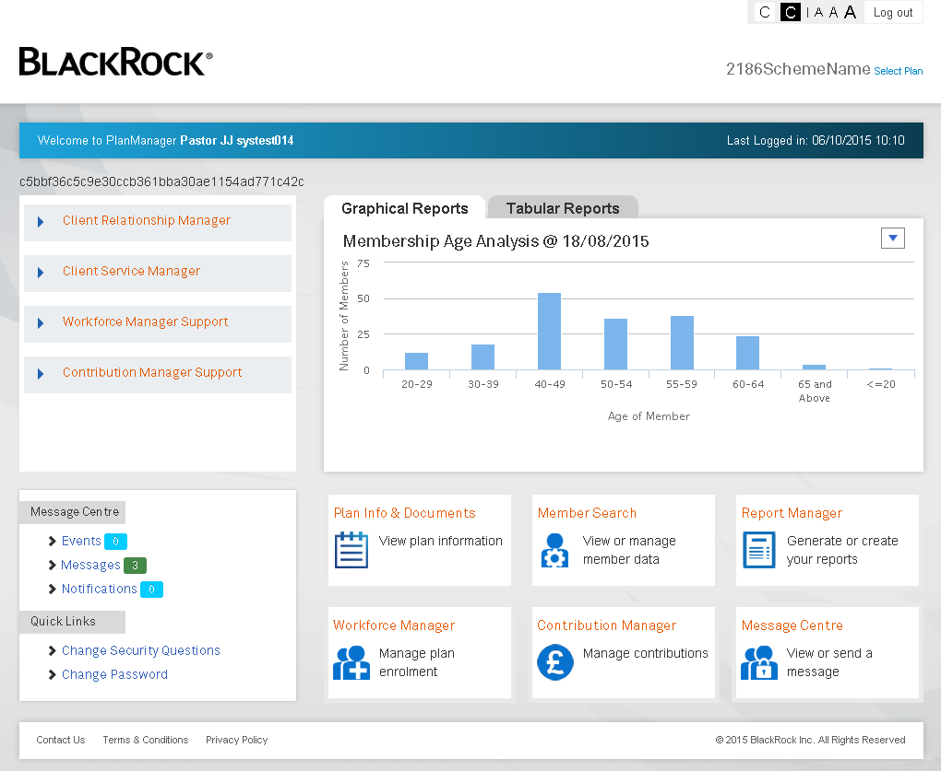

Slide 5
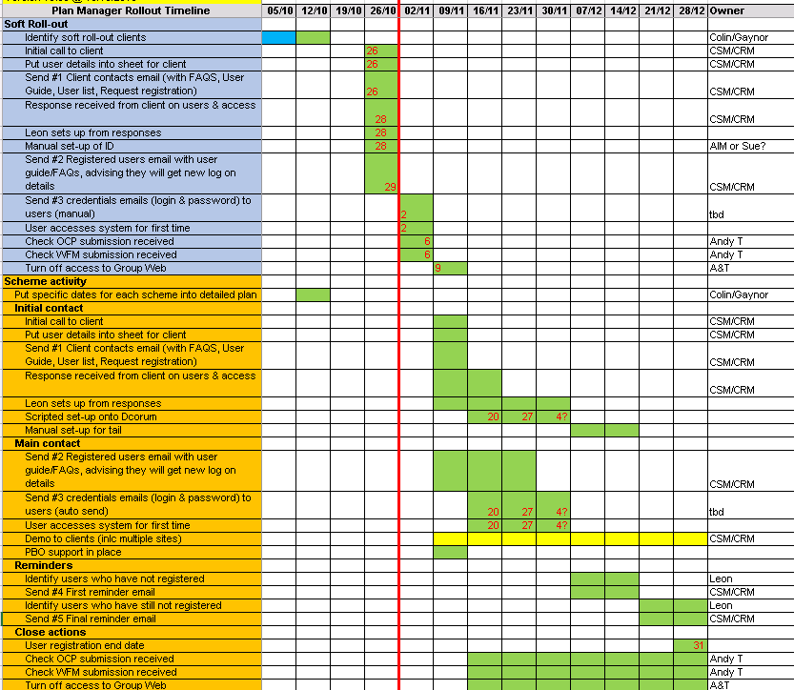
PlanManager – Roll Out – Indicative Schedule

Slide 6
Accessing PlanManager – User Set Up
Before anyone can access PlanManager they need to be set up as a PlanManager User
A PlanManager User is known as an “Admin User”
As part of the roll out all existing Group Web users will be set up as Admin Users (the Plan lead contact will be asked to verify users)
For new “Plans” the client spec has been updated to complete an access form
Admin Users are created via a DCorum screen (by AIM)
Each Plan requires one or more Roles setting up (OCC - Systems Team)
A role defines what permissions and what data can be accessed/seen
Each Admin User needs to be linked to a role (OCC – Systems Team or AIM)
An Admin User can only be linked to one role at any point in time
More details about User Set up will be provided to the specified teams in detailed training sessions

Slide 7
Accessing PlanManager - URL
The current Group Web URL is:
https://www.blackrockpensions.co.uk/blackrock-emplogin.asp
Or
https://www.dclink.co.uk/
These are being replaced by:
https://www.blackrock.co.uk/planmanager/
** Users will need to replace any of their broswer favourites that currently link to Group Web to link to the new URL. There will be no redirection from Group Web to the new URL! **

Slide 8
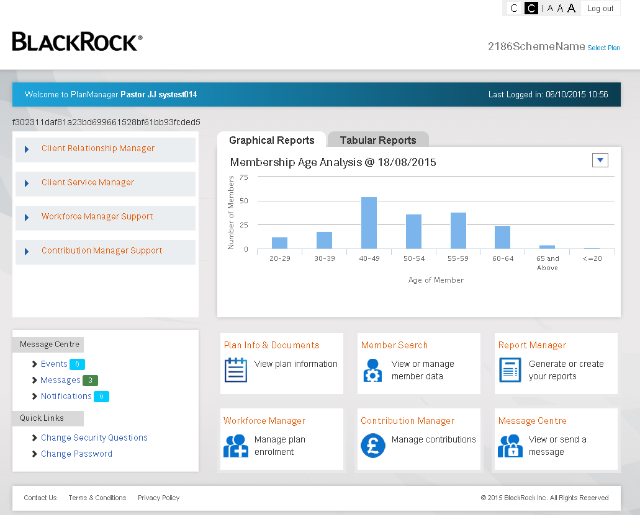
PlanManager Functionality
WCAG 2.0 AA standards for accessibility and equality
Log out
Plan specific contacts
Dash reports
Message Centre
Member Search
Report Manager
Plan Information and documents
Quick Links
Contact Us, T&C’s, Privacy Policy
Message Centre
Workforce Manager
Contribution Manager

Slide 9
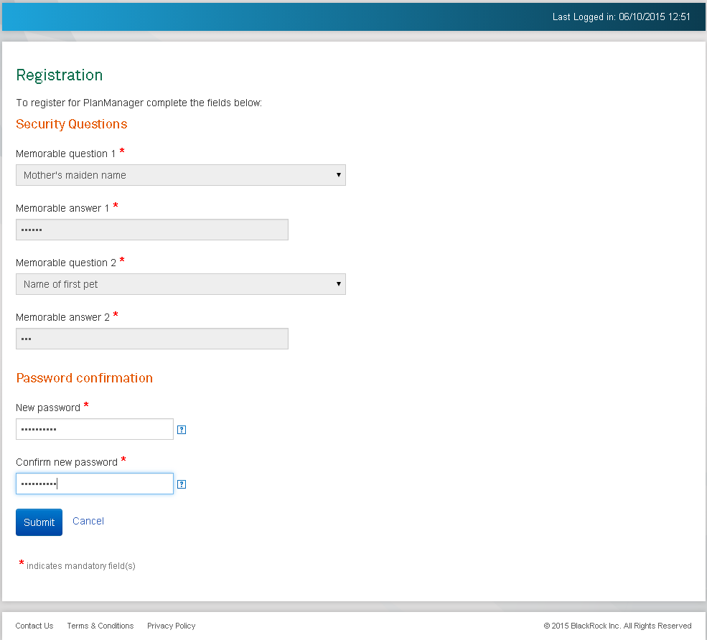
PlanManager – User Registration
Navigate to PlanManager Login screen
Enter UserID and Password
Select Login
System detects first time login
Displays Security Questions section
4 standard questions, plus a create your own question
Question 1 & 2 cannot be the same
Answer 1 & 2 cannot be the same
Select Next
Displays Password section
Enter a new password
Confirm new password
8 characters, at least 1 capital letter, 1 lower case letter, may contain special characters
Select Submit
Registration example screen shot

Slide 10
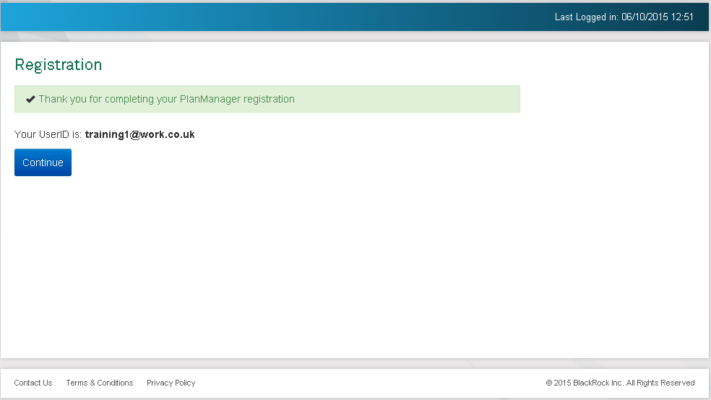
PlanManager – Registration Confirmation
Registration Confirmation message displayed
Confirmation of UserID
Select Continue
Registration Confirmation example screen shot

Slide 11
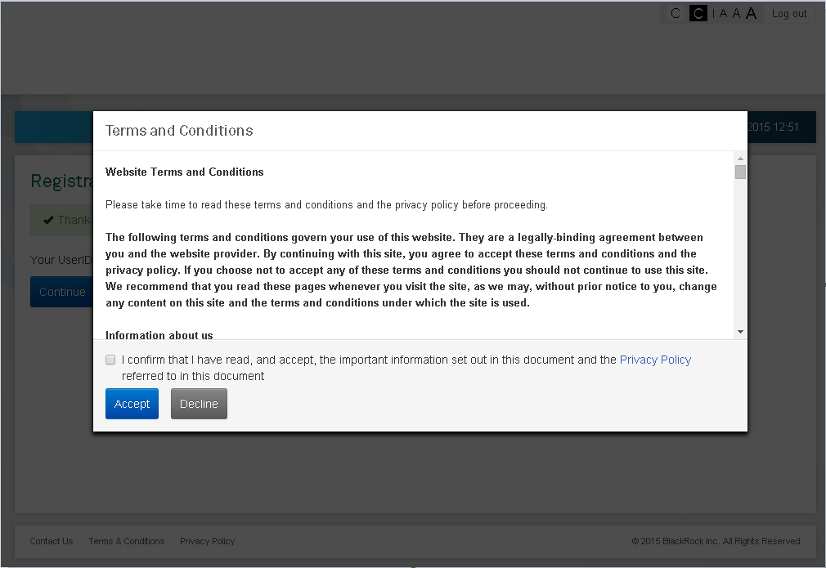
PlanManager – Terms and Conditions
Website Terms and Conditions are displayed
Same wording as for TargetPlan
To continue the Terms and Conditions have to be accepted by ticking the confirm box and pressing the Accept button
The system records the date, time and version accepted.
Decline goes back to Login screen
Website Terms and Conditions have to be accepted under the following rules:
First time login
If they have changed since the last time they were accepted
Every 6 months
PlanManager Home screen is displayed
The Terms and Conditions or Privacy policy can be viewed at anytime once logged in by clicking on the links in the footer
Terms & Conditions example screen shot

Slide 12
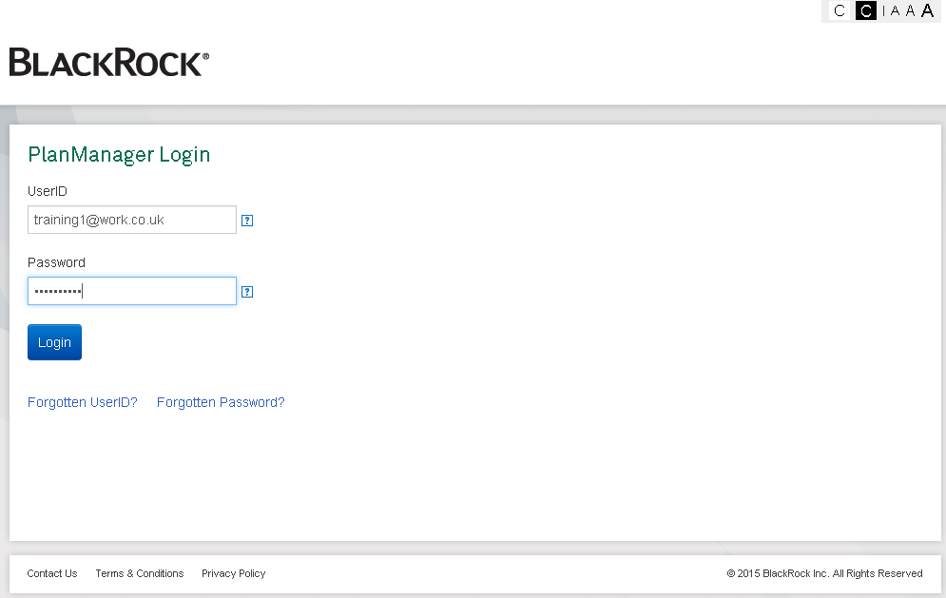
PlanManager - Login
Enter UserID
Enter Password
Select Login
PlanManager home page displayed
Login screen example screen shot

Slide 13
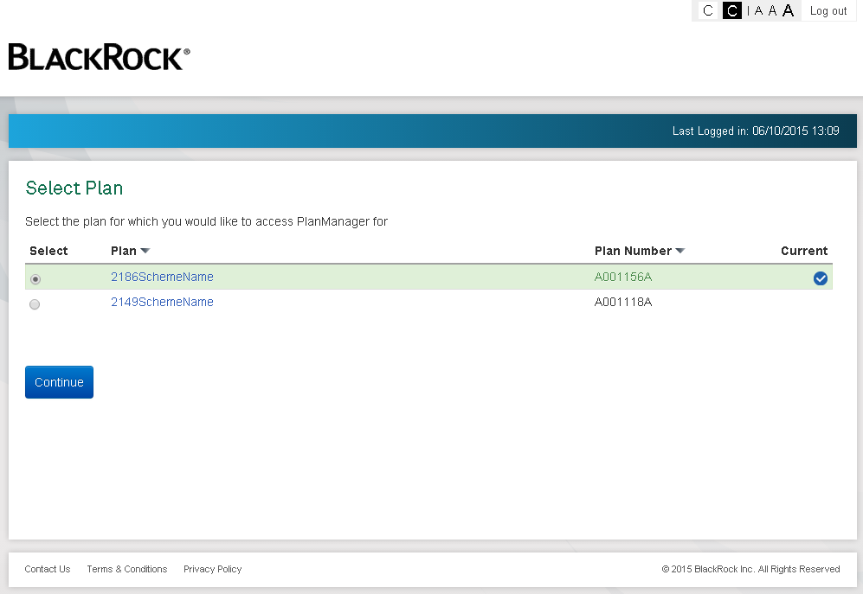
PlanManager – Select Plan
Where a user is linked to role that is linked to multiple plans the Select Plan screen is displayed
If only one plan is linked to the role then the user is taken straight to the PlanManager home screen
The current tick box displays the “primary” plan
First time in it’s the plan at the top of the list
Subsequent logins it’s the plan that the user had open last
Select Plan – example screen shot

Slide 14
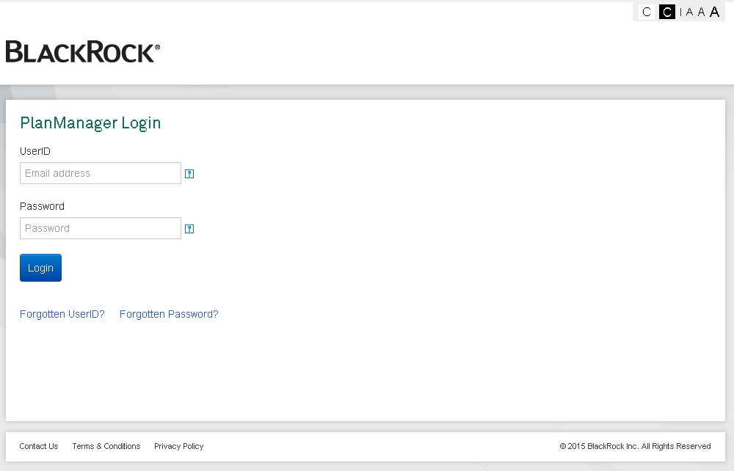
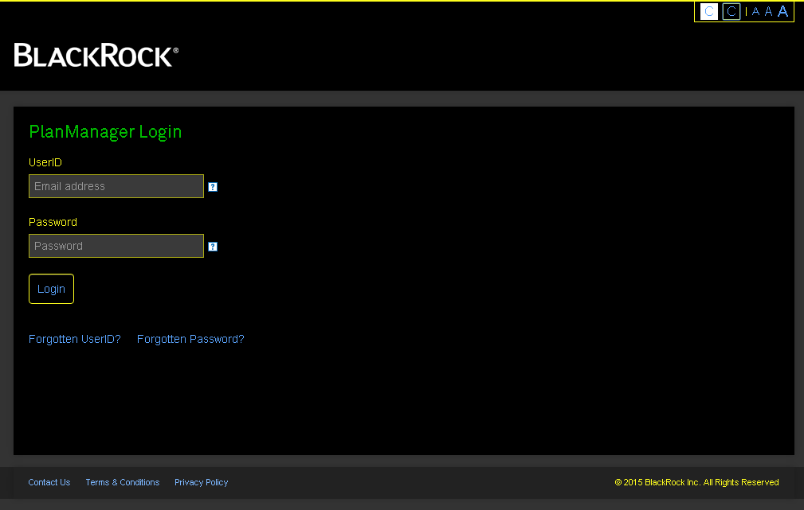
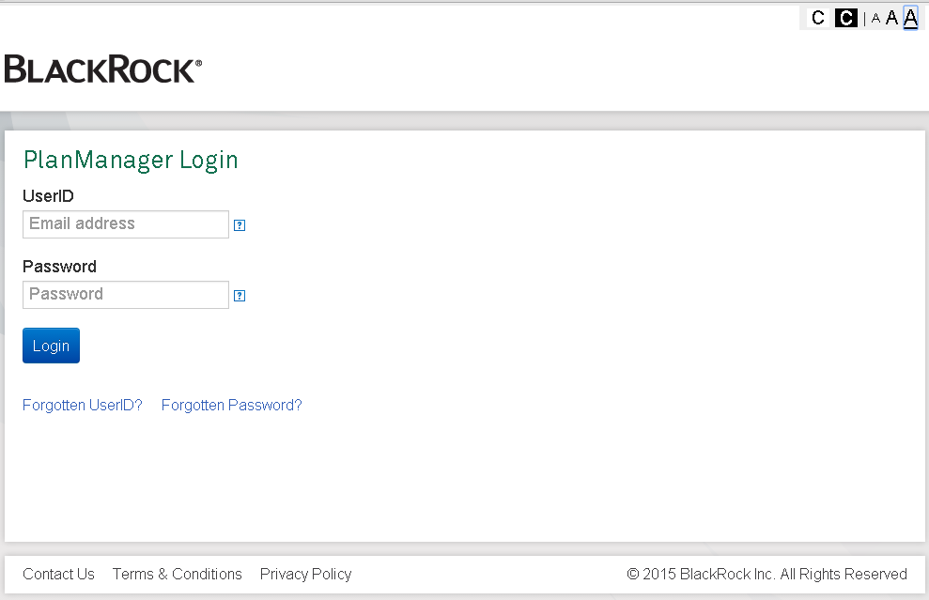
PlanManager – WGAG 2.0 AA Standards
WGAG 2.0 AA Standards are the standards that websites adopt to enable users to change the font size and or colour plans in the case of poor eyesight or colour blindness
Click on the black C to change the colour plan
Click on the A’s to change the font size
WGA2 2.0 AA Standards – example screen shots

Slide 15
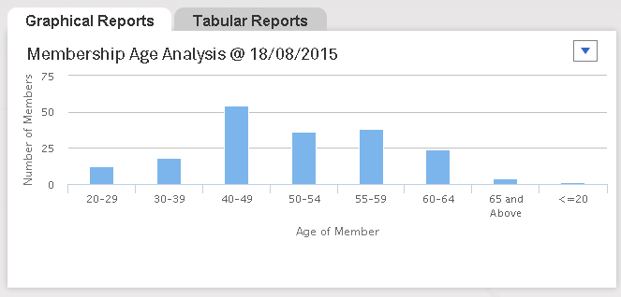
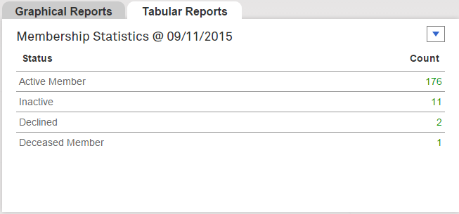
PlanManager – Dash Reports
Dash Reports appear on the PlanManager home page
There are two types of dash report:
Graphical:
Plan Investments
Membership Age Analysis
Tabular:
Plan holdings
Membership statistics
The system will automatically run each of 4 dash reports for all plans
They are a snapshot of data as at yesterday’s date
Users should go to Report Manager for detailed reports
Dash Reports – example screen shots

Slide 16
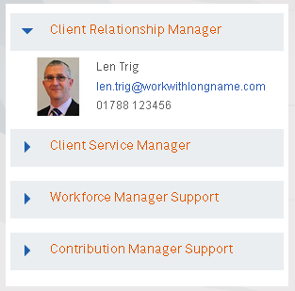
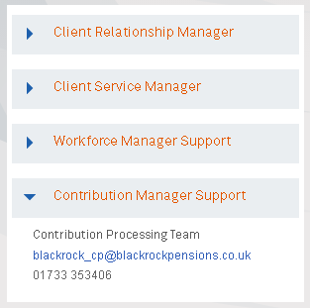
PlanManager - Contacts
Named contacts can be linked to a specific contact type
There are four contact types available:
Client Relationship Manager
Client Service Manager
Workforce Manager Support
Contribution Manager Support
Each contact type can display:
Contacts picture (if this is a team no picture is displayed)
Name
Email Address
Phone Number
Contacts have to be added to the Plan as “Misc Contacts” first (via Compass)
The “Misc Contacts” can then be mapped to one of these four contact types via a new DCorum screen
If no contacts have been set up on a plan this section will not be displayed
Plan specific contacts – example screen shot

Slide 17
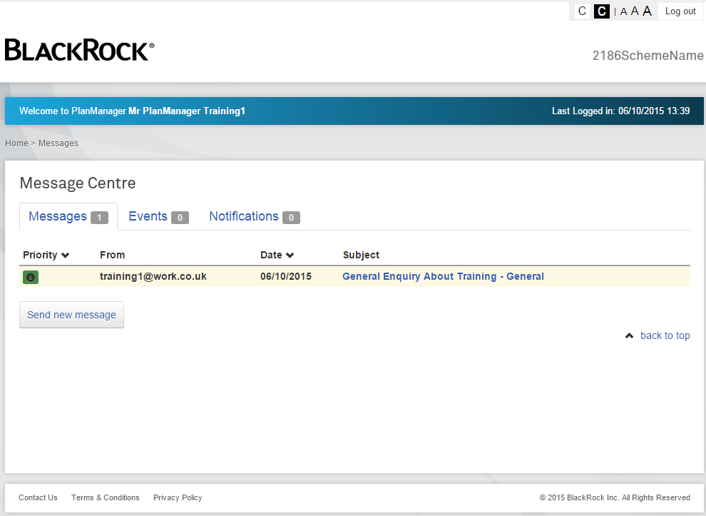
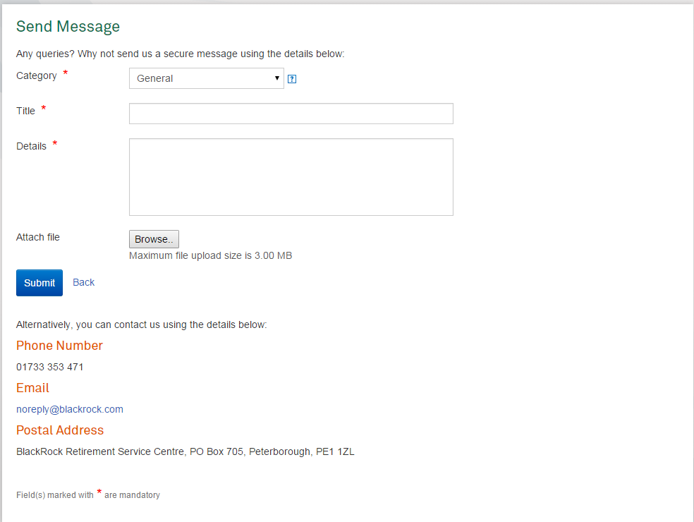
PlanManager – Message Centre
The message centre enables users to send messages to the Administration centre
Messages need to be categorised:
General (GENWORK)
Contribution Enquiry (GENWORK)
Auto Enrolment Enquiry (GENWORK)
Member Query (INFOREQ)
Member Update (CHNGPERS)
Each of these categories map to an AWD work item which is created upon the user selecting Submit
The user can attached a file to the message
.csv
.txt
Max file size is 3MB
The file is saved to a network drive and the location is detailed in the AWD item comments
Administration Centre users can respond to messages via a DCorum screen
Message Centre – example screen shot

Slide 18
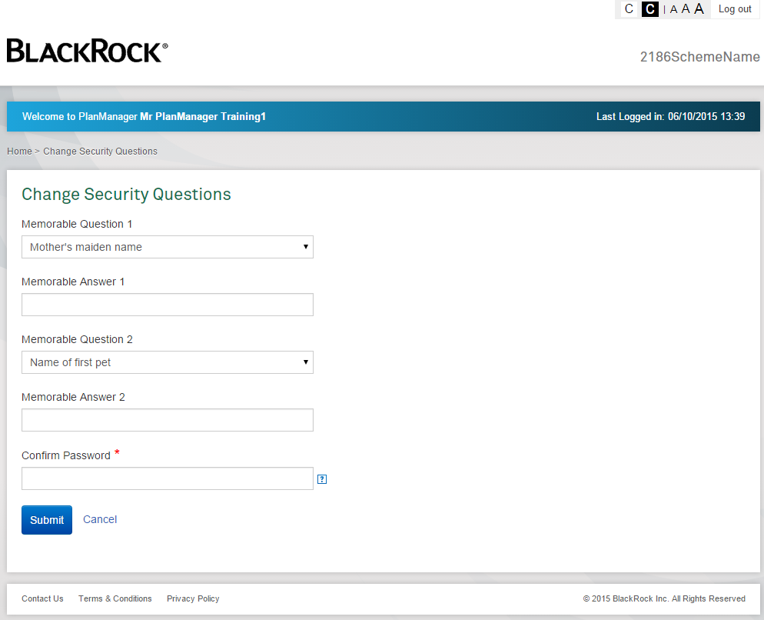
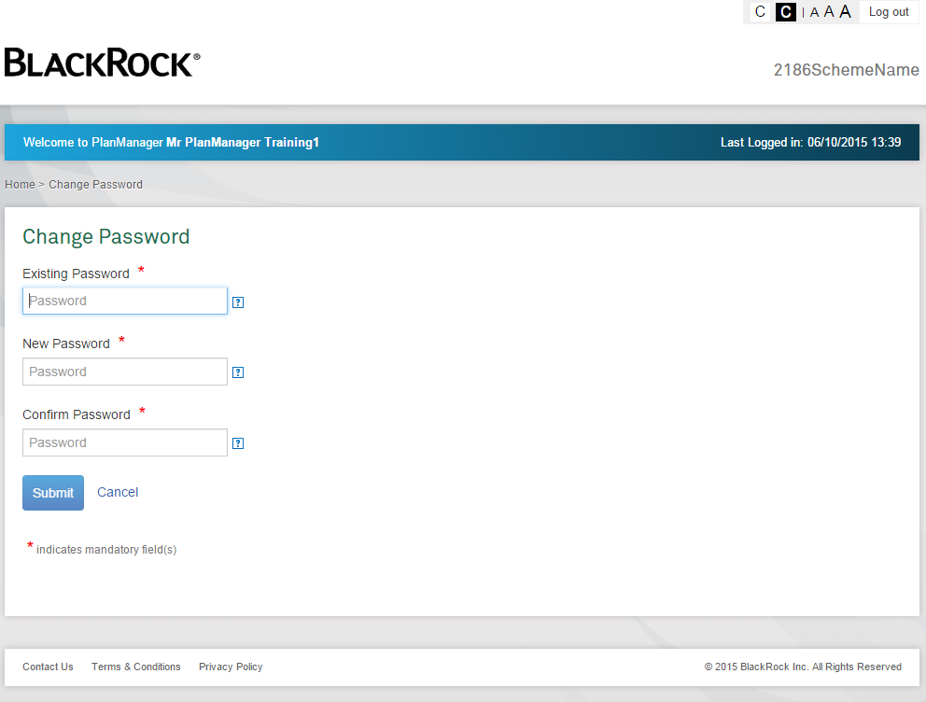
PlanManager – Quick Links
Quick links allow users to:
Change their Security Questions and Answers
Change their Password
Quick Links – example screen shots

Slide 19
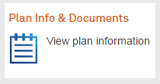
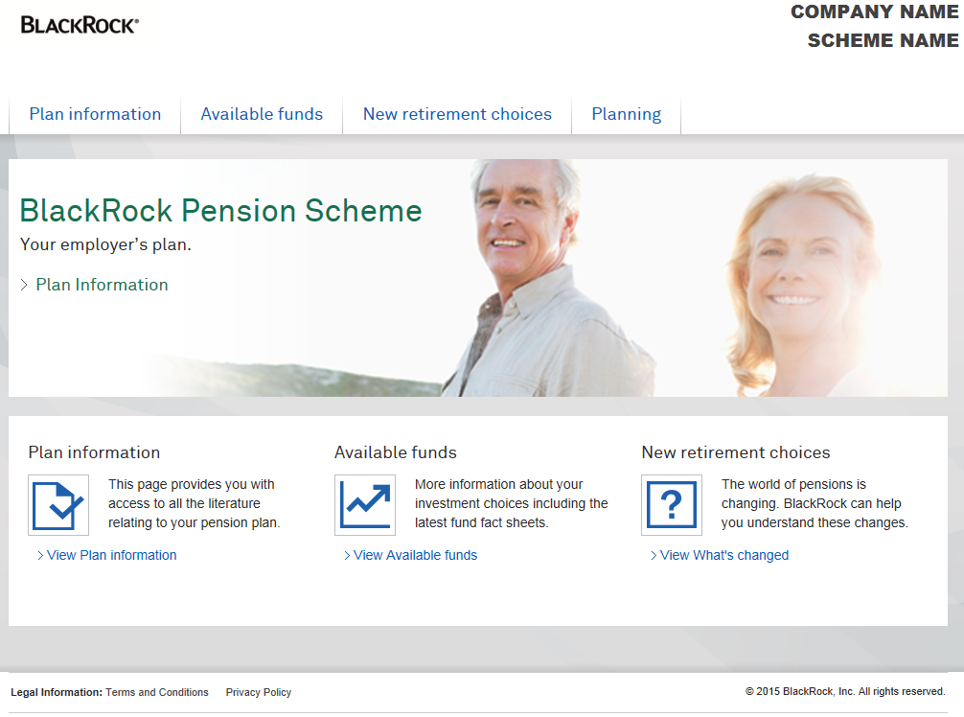
PlanManager – Plan Information and Documents
Each Plan has it’s own “Plan Information and Documents” page
Clicking on the link from the home page will launch the plan specific page in another browser window
Same as the TargetPlan equivalent
Allows user to view
Plan Information i.e. plan specific PDF’s such as:
Investment Options
Plan Summary
Member booklet
Available Funds
Retirement Choices
Planning
Plan Info and Documents – example screen shot

Slide 20
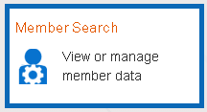
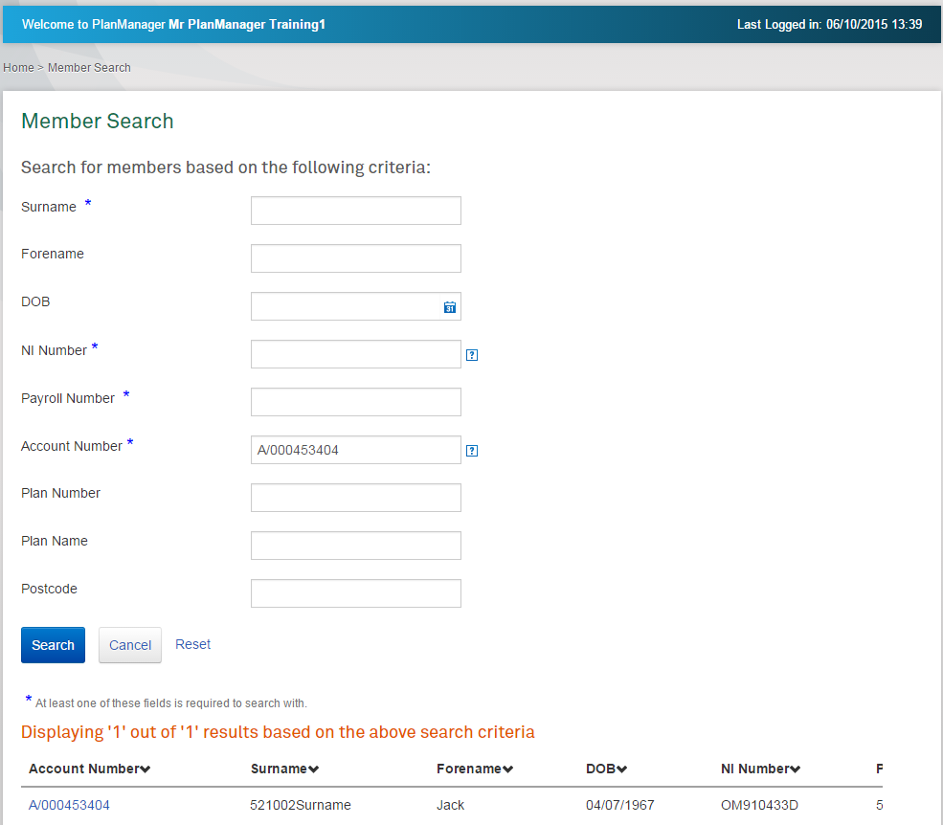
PlanManager – Member Search
NB: Initially this function will be turned off for all PlanManager users due to the Compliance issue’s around accessing member data!
Member search allows PlanManager users to search for their members and view their details
Only allowed if the role the user is linked to permits
For example a Trust Based plan would have it, whereas a Contract Based plan would only be able to see Active Members
Member search can also be turned off at plan level
Upon searching for a member any matching records are displayed in the bottom section of the screen
Selecting a record to view will launch TargetPlan in a separate browser window
TargetPlan will be launched in view only mode (this uses the TargetPlan Impersonate functionality). Some users could be set up with update access if required.
Member Search – example screen shot

Slide 21
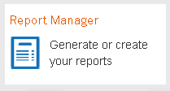
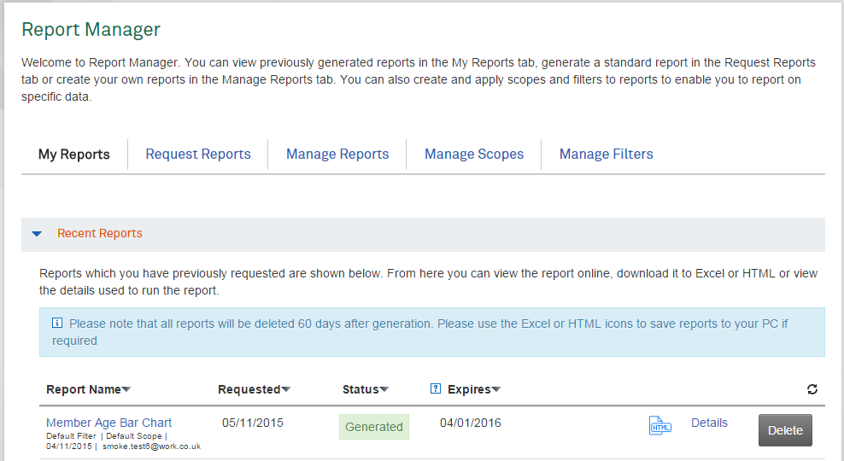
PlanManager – Report Manager
Report Manager is the reporting module of PlanManager
Report Manager is accessed by selecting the Report Manager link on the home screen
Access is controlled at Role Level – so not all users may have Report Manager
Report Manager can be switched off completely at plan level if a plan doesn’t want to use it
Report Manager allows users to:
View and run standard reports
Create custom reports
View and run direct reports (if configured to do so)
Define and apply a scope
Define and apply filters
Download reports (Excel or HTML)
Print reports
Delete Reports (manual and automated)
(each item will be covered in detail in later slides)
All reports are run in the background
This means that the front end isn’t locked while a report is run
Report Manager – example screen shot

Slide 22
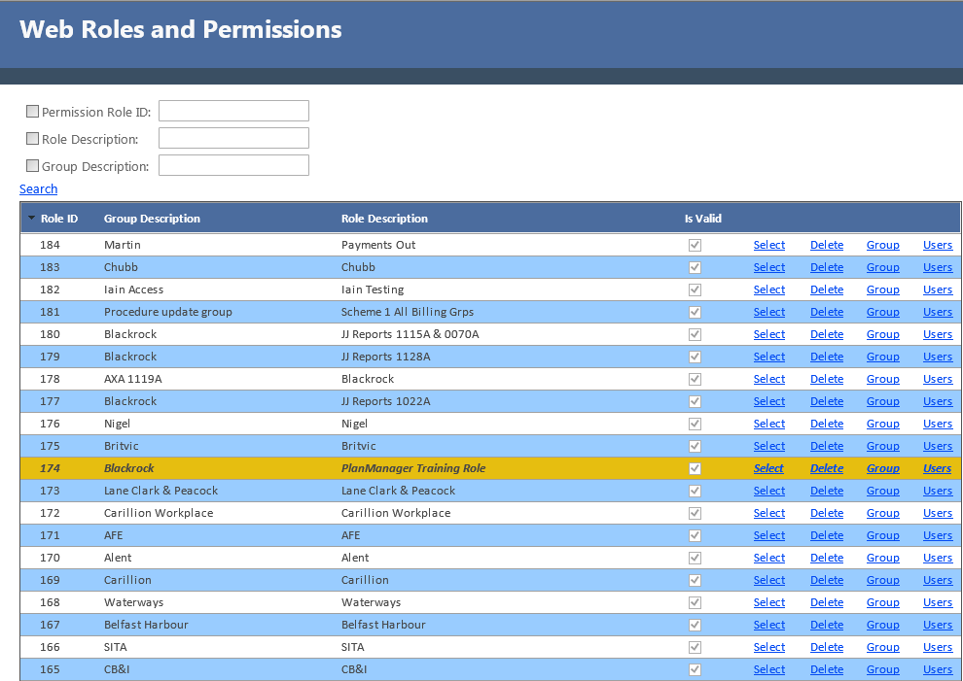
PlanManager – Report Manager – What is a Role?
What is a Role?
A role is a set of permissions that define plan and report manager access
A screen in DCorum is available to create, view or maintain the roles
Example Roles:
XYZ Scheme – Executive Member Group Only
Any users linked to this role would only be able to see members linked to the Executive Member Group
ABC Retirement Savings Plan – Monthly Paid Employees
Any user linked to this role would only be able to see members linked to the “Monthly” billing group
The Pension Plan – Standard Access
Any user linked to this role would be able to see all members and have access to Report Manager
More details are on the next slide for information. The OCC – System team will have detailed training on how to set up the different permissions
Dcorum Web Roles and Permissions example screen shot

Slide 23
PlanManager – Report Manager – Role Details
What is a Role?
The Dcorum Web Role and Permissions screen has the following settings
Full Control, Read only or Deny are the permissions that can be applied to the Plan and Report Manager Permissions listed below
The permissions available are:
Allow Impersonation?
Member Status group permissions for Reporting
Member Status group permissions for Impersonation
The plans that are available to the role
Plan Permissions
Then for each plan:
Each of the Benefit Member Groups
Each of the Investment Member Groups
Each of the Billing Groups
Each of the Employers
The default permission is “Read Only”
This data controls what the user will see on the scopes screen, what members they can search for, what they can do in TargetPlan, what data is returned in a report
Report Manager Permissions
Screen Permissions - Controls what Report Manager screens are available to the role
Request Report
Create Report
Delete Report
View Report
Download (Excel)
Direct Report Permissions
Standard Report Permissions
Custom Report Permissions

Slide 24
PlanManager – Report Manager – What is a Scope?
What is a Scope?
A scope controls the plan specific population of data that is selected and returned to the report results
Examples scopes could be:
Scope for members in a specific Benefit Member Group e.g. 2% Match Member Group
Scope for members in a specific Billing Group e.g. Billing Group A
Scope for members linked to a specific Employer e.g. Employer 1
Scope for members in specific Investment member group e.g. AE Cash Investment Group
Or members in a combination of these, e.g. Members in Employer 1 or Billing Group A
Scope for members in multiple plans e.g. All Members in Plan 1 or Plan 2
The data displayed on the Manage Scopes screen is controlled by the permissions set up in the role
Scopes can be set up in advance
Scopes are available to all users linked to the role
Scopes can be set up to return data in the report for the following types of plan information:
Plans (i.e. plans) where >1 linked to the role
Benefit Member Groups
Billing Groups
Employers
Investment Member Groups
Scopes can then be linked to reports when they are run

Slide 25
PlanManager – Report Manager – What is a Scope?
Default Scope – Current Plan
Member Group 1 Scope
Member Group 1 or Billing Group 2 Scope
Member Group 1 or Billing Group 2 or Employer 3 Scope
This is a scheme
Members can be in any combination of Member Group, Billing Group or Employer
Member Groups
Member Group 1
Member Group 2
Member Group 3
Billing Groups
Billing Group 1
Billing Group 2
Billing Group 3
Employers
Employer 1
Employer 2
Employer 3
This slide is designed to be played with animation

Slide 26
PlanManager – Report Manager – What is a Filter?
What is a Filter?
A filter is used to restrict the data returned in a report by setting certain criteria
Example filters could be:
Males Only
Age less than 75
Aged between 50 and 75
Account Balance more than £50,000
Pensionable salary equals £100,000
Or any combination:
Females > 50 and balance < £50,0000
Filters can be set up is advance
Filters can be applied to reports when they are run
Some reports are configured to not allow filters to be selected
Filters are available to all users linked to the role
Filters can be set up to return data in the report for the following types of generic data:
Personal Data
Age, Gender, Target Retirement Age
Account Data
Registered for TargetPlan, Account Status, Effective date of account status, Date Joined Plan, Account Balance, Pensionable Salary
Contribution Data
Salary Sacrifice £ and %, Member Contribution £ and %, Employer Contribution £ and %, AVC £ and %, Total Contribution £ and %
Auto Enrolment Data
Auto Enrolment Recommendation

Slide 27
PlanManager – Report Manager – What is a Direct Report?
What is a Direct Report?
A direct report is a type of report that can be configured at plan level to allow data from an alternative source to be generated via Report Manager
Example direct reports could be:
A spreadsheet of data from the HR system
A PDF of investment information
Direct reports have to be configured for each plan via a new DCorum Screen
Once configured they will appear as a report type on the Request Report screen in Report Manager
Parameters can be defined for a direct report, for example:
Plan Number
Date (supports monthly or annually)

Slide 28
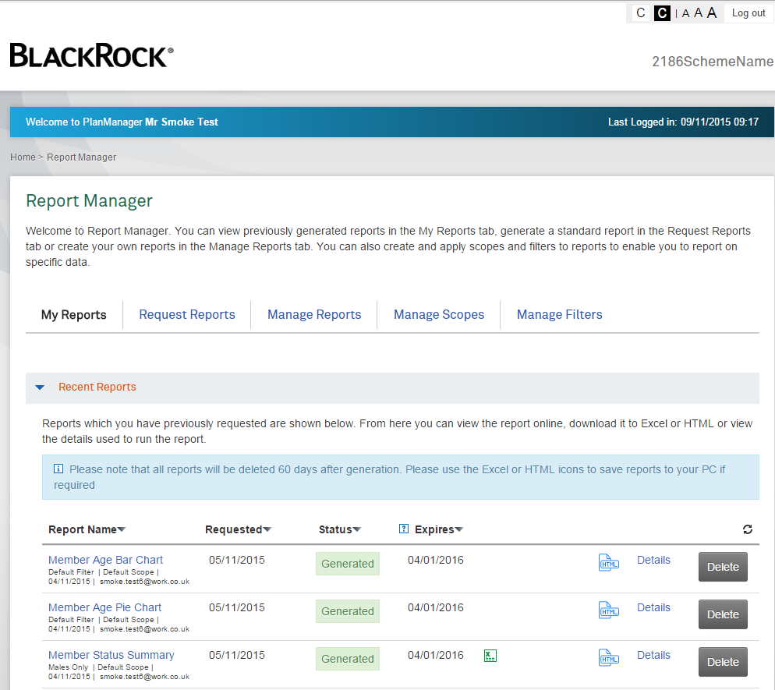
PlanManager – Report Manager – My Reports
My Reports is the screen landing screen when accessing Report Manager
Displays any reports previously run
This shows ALL reports linked to the role and not just for the logged in user
Details available are:
Report name
Filter used
Scope used
Date run
User who requested report
Requested date
Status
In progress
Generated
Failed
Expires (the date the report will be automatically deleted)
Download icons (can be configured per report)
Excel or zip (for a large file)
HTML
Details (shows more details about the report)
Delete (if role allows)
My Reports – example screen shot

Slide 29
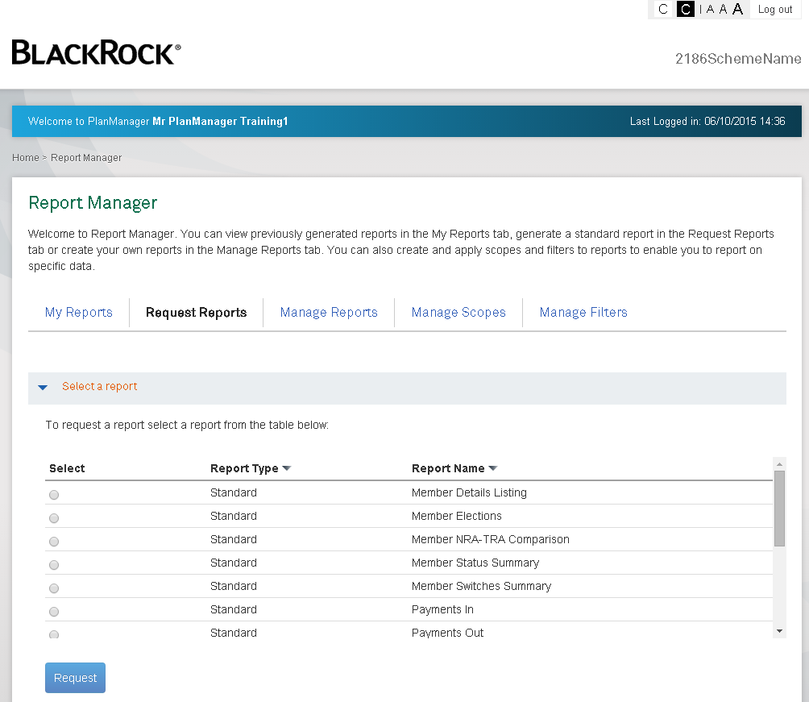
PlanManager – Report Manager – Request Reports
Request Report is the screen used to run a report
Displays a list of reports available to run based of the role permissions
The down arrow enables sorting on that column
3 different report types
Standard, with pre-defined content
Custom, with user-defined content
Direct (see earlier slide)
To run a report select it and then press “Request”
Select a scope to run the report for (defaults to “Default Scope”)
Select a filter to run the report for (where applicable, defaults to “Default Filter”)
Select the date range to run the report for
Select “Request Report”
Report requested confirmation message displayed
Navigate to My Reports or Request another Report (because reports run in the background many reports can be requested at the same time)
Request Reports – example screen shot

Slide 30
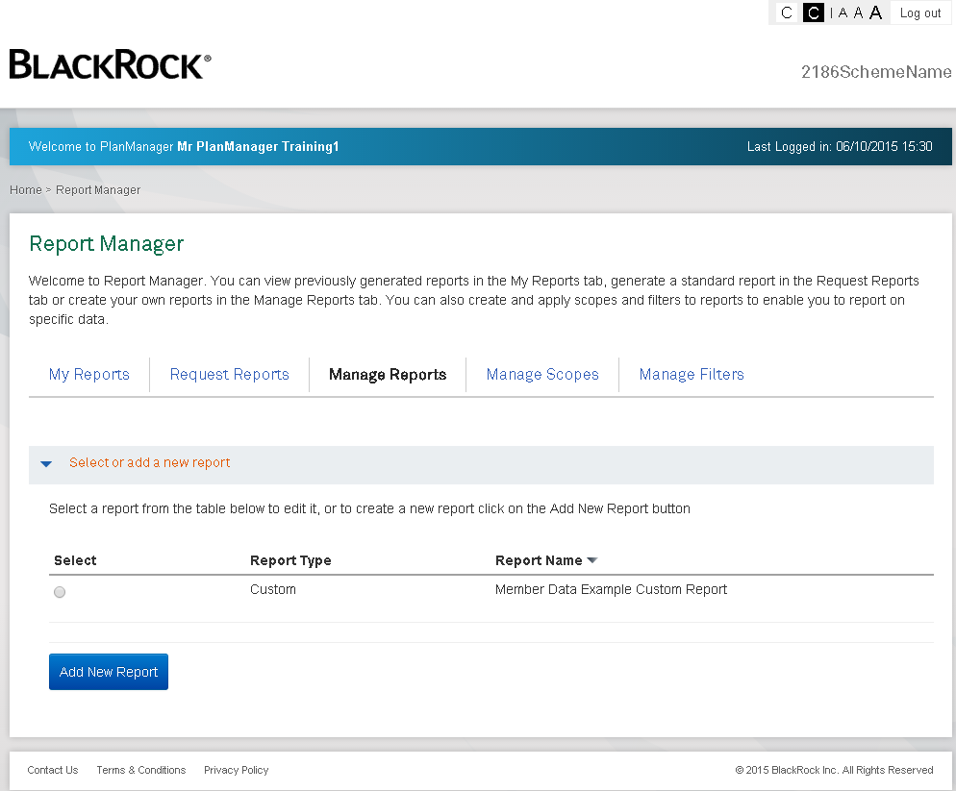
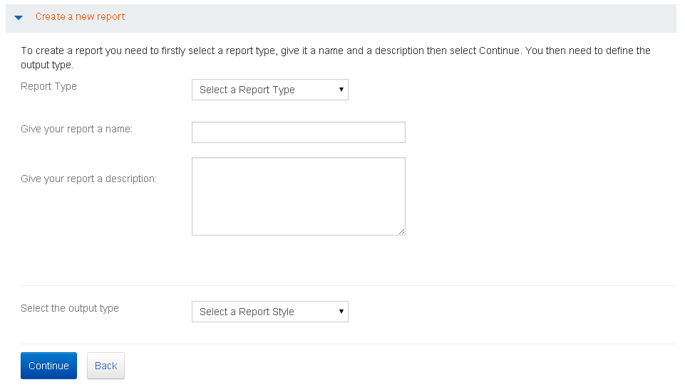
PlanManager – Report Manager – Manage Reports
Manage Reports is the screen used to create or edit a custom report
There are 3 types of custom report:
Member Data
Member Contribution Data
Member Transaction History Data
The type of custom report selected controls the data items available for selection
There are 3 different output types available:
Bar
Pie
Tabular
The type of output selected controls the number of items that can be selected
Select a scope to run the report for
Select a filter to run the report for
Select the date range to run the report for
Select “Generate”
Report requested confirmation message displayed
Navigate to My Reports or Request another Report (because reports run in the background many reports can be requested at the same time)
Manage Reports – example screen shot

Slide 31
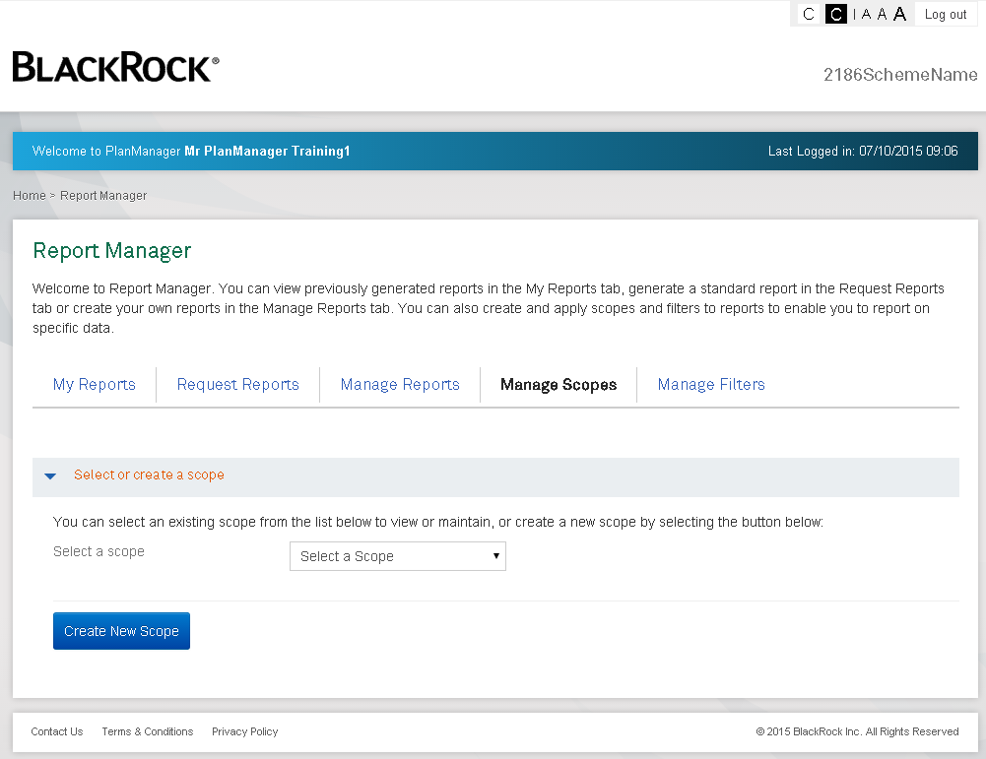
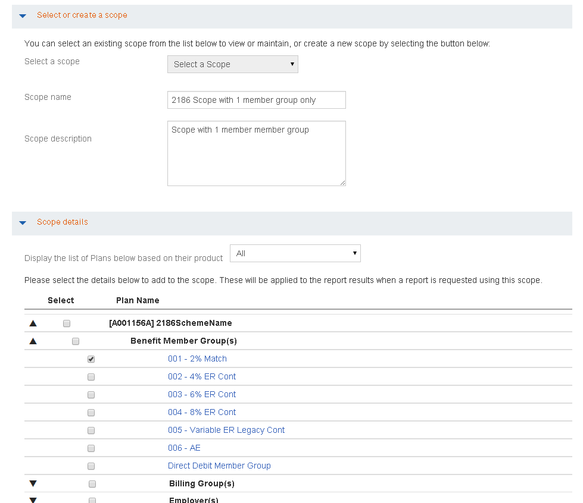
PlanManager – Report Manager – Manage Scopes
Manage Scopes is the screen used, to create, edit or delete a scope
Scopes control the plan specific data that can be applied to a report to restrict the data returned, or to run a report across multiple plans:
Plans
Benefit Member Groups
Billing Groups
Employers
Investment Member Groups
The data available to the Manage Scopes screen is defined by the role the user is in
All users of the role can use any of the scopes linked to the role
Once a scope is defined it can be applied to any of the standard or custom reports
Manage Scopes – example screen shot

Slide 32
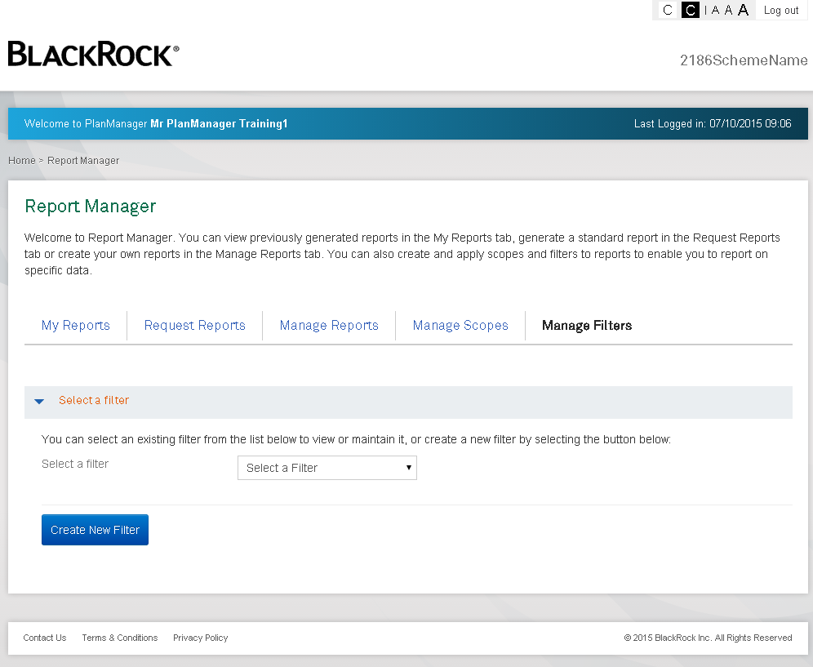
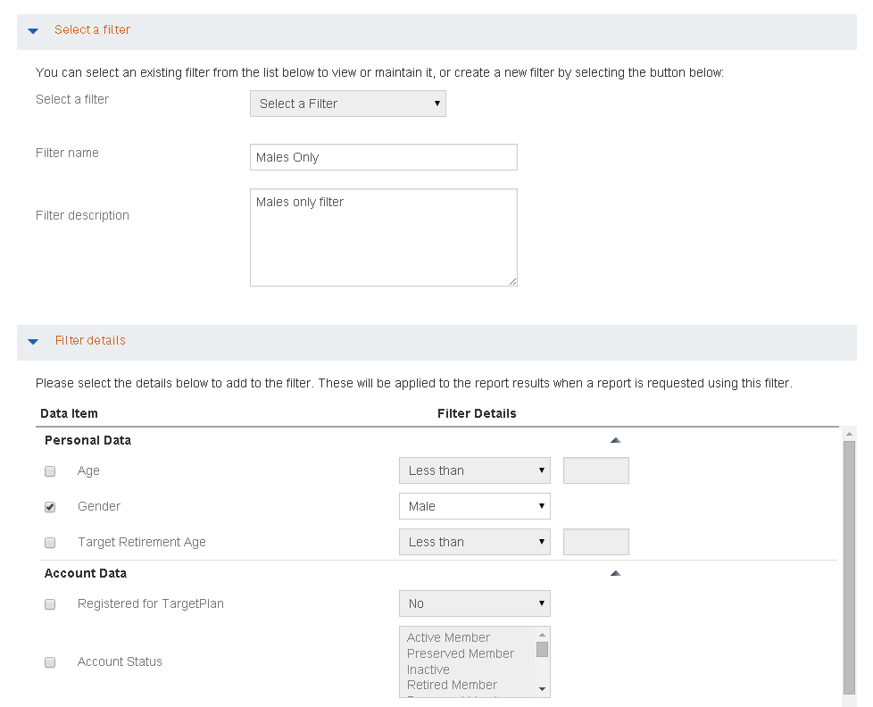
PlanManager – Report Manager – Manage Filters
Manage Filters is the screen used to create, edit or delete a filter
Filters control generic data that can be applied to a report to restrict the results returned:
Personal Data
Age, Gender, Target Retirement Age
Account Data
Registered for TargetPlan, Account Status, Effective date of account status, Date Joined Plan, Account Balance, Pensionable Salary
Contribution Data
Salary Sacrifice £ and %, Member Contribution £ and %, Employer Contribution £ and %, AVC £ and %, Total Contribution £ and %
Auto Enrolment Data
Auto Enrolment Recommendation
All users of the role can use any of the filters linked to the role
Once a filter is defined it can be applied to any of the standard or custom reports (provided the report configuration allows)
Manage Filters – example screen shot

Slide 33
PlanManager – List of Reports
Standard Reports
Plan Statement
Plan Transaction Summary
Plan Investment summary by fund
Plan Investment summary by Money type
Member Listings
Member Reconciliation Report
Payments Out
Payments In
Plan Transaction History
Member Switches Summary
Auto Enrolment Report
Plan Valuation by Member
Contribution Level Split
Member Status Summary
Member Elections Report
Target Plan Statistics
Member Balance Report (age)
NRA-TRA Comparison Report
Custom Reports
Member Data
Member Contribution
Member Transaction History

Slide 34
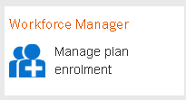
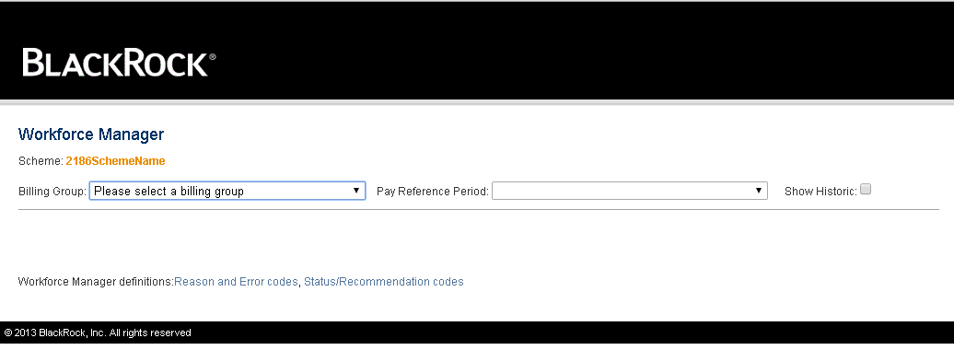
PlanManager – Workforce Manager
Workforce Manager is where users go to manage their plan enrolment i.e. load AE files
It is accessed from the Workforce Manager link on the PlanManager home screen
Only users set up to use WorkForce Manager will have access to it
Upon selecting Workforce Manager the existing WFM application is launched in a new browser window
No changes to WFM functionality have been introduced with PlanManager. It is just the way users access it that has changed!
Workforce Manager – example screen shot

Slide 35
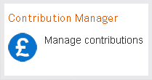
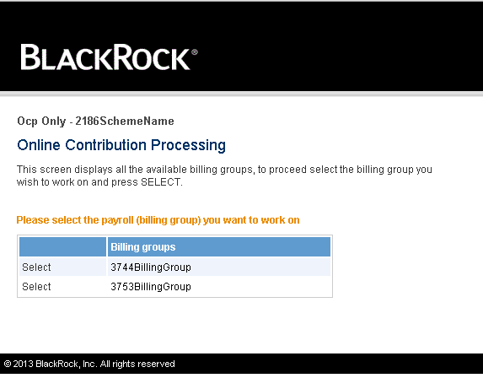
PlanManager – Contribution Manager
Contribution Manager is where users go to manage their contributions i.e. load OCP files
It is accessed from the Contribution Manager link on the PlanManager home screen
Only users set up to use OCP will have access to it
Only new OCP is supported
Upon selecting Contribution Manager the existing OCP application is launched in a new browser window
No changes to OCP functionality have been introduced with PlanManager. It is just the way users access it that has changed!
All plans have now been migrated to “new OCP” (except Cobham)
Contribution Manager – example screen shot
New ocp only

Slide 36
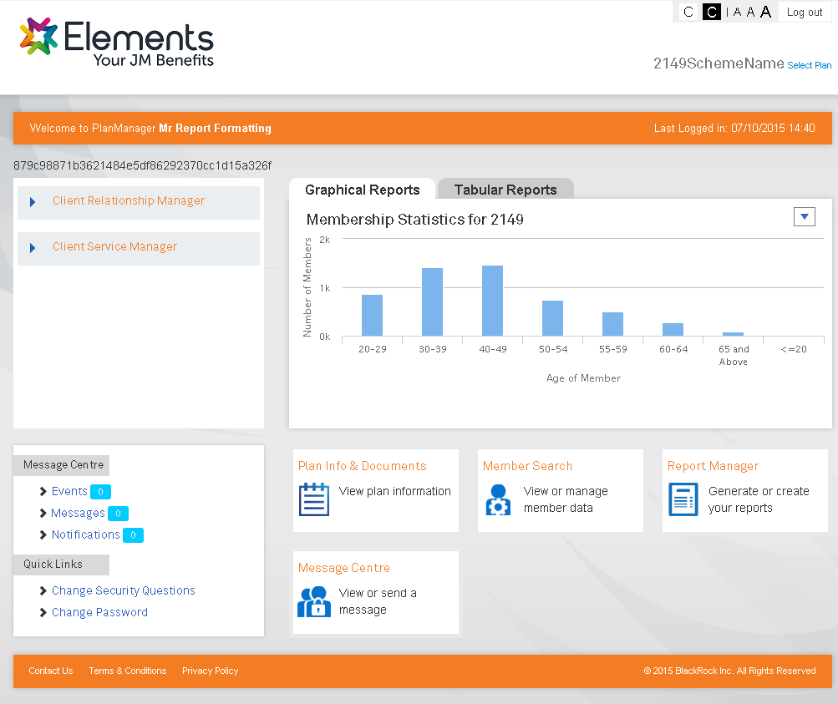
PlanManager – Branding and Content Management
PlanManager will pick up any branding already applied to TargetPlan, this includes:
Logos
Colour Plans
Content Management
PlanManager uses the same Content Management system that TargetPlan does.
Most items on the screen can be varied at the following levels:
Provider
Product
Plan
Member Group
If no override at the above levels the “Default” content will be displayed.
The following items cannot be varied by content
Filter Data item labels
Scope Data items
Custom Report Data item labels/column headings
Standard Report column headings
PlanManager Branding Example screen shot

Slide 37
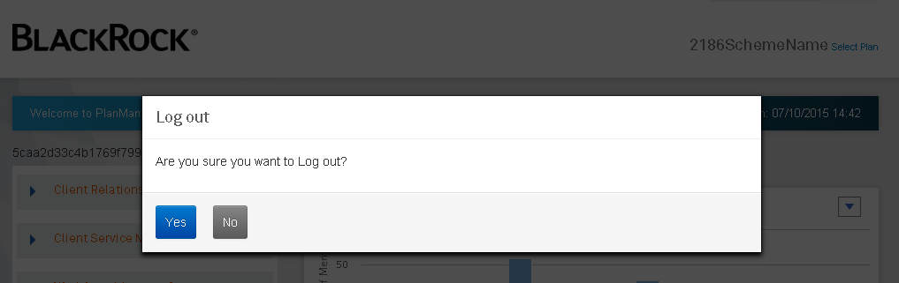
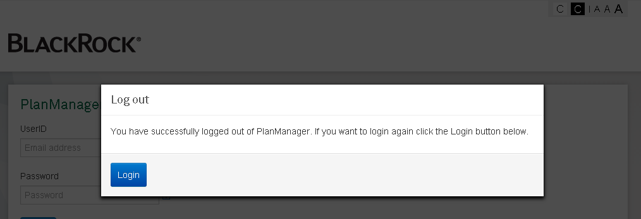
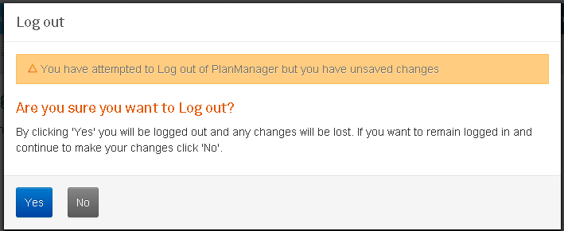
PlanManager - Logout
Upon selecting Log out the user is presented with an “Are you sure? Message
Yes – displays log out confirmation
No – returns user to screen they were on when they selected Log out
Logout with unsaved changes.
System detects there are unsaved changes and warns the user
Logout – example screen shots

Slide 38
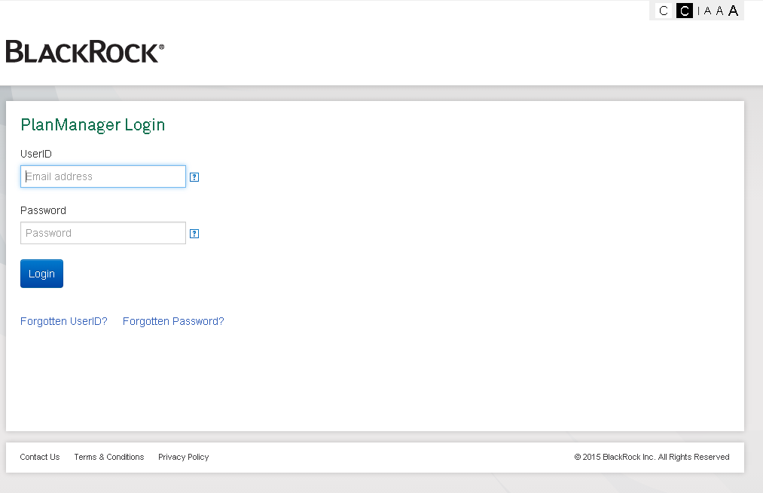
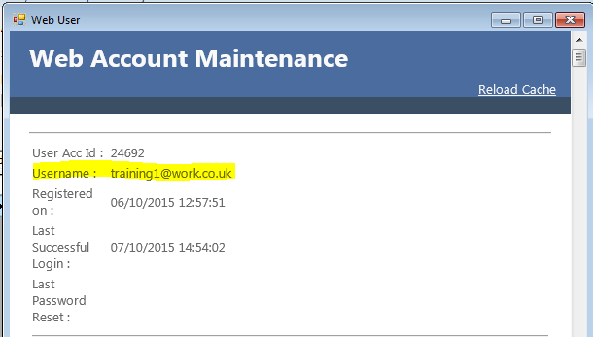
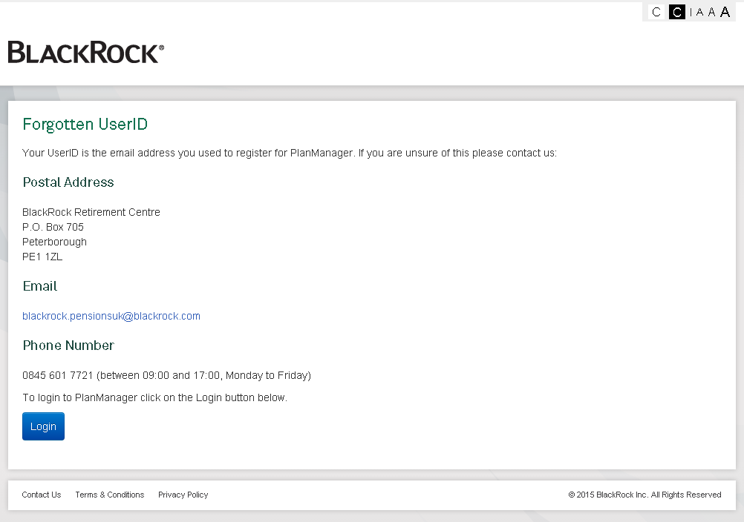
PlanManager – Forgotten User ID
Selecting Forgotten UserID link from the Login screen displays the Forgotten UserID screen
Displays generic contact details
(Plan specific cannot be displayed here as we don’t know who the user is)
The Contact Centre can find out the User ID from the Web User screen in DCorum
Search for Person in DCorum
Navigate to Pension – Person – Web User
UserID is the Username (as highlighted below)
Forgotten User ID – example screen shot

Slide 39
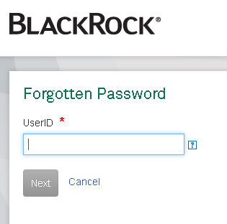
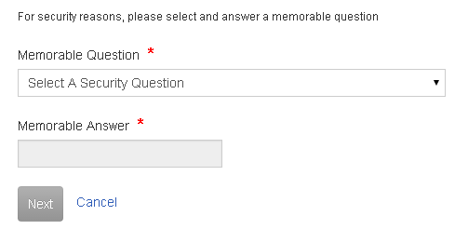

PlanManager – Forgotten Password
Selecting Forgotten Password link from the Login screen displays the Forgotten password screen
User has to enter their UserID
Select Next
Select one of the previously defined Security Questions
Provide the correct answer
Select Next
Enter a new password
Confirm Password
Select Submit
Forgotten Password – example screen shot

Slide 40
PlanManager – Forgotten Password continued…..
The Contact Centre cannot reset a users password
The user therefore needs to raise a Tech Request Form for AIM to resolve the problem
AIM can then update the password
This will force the user through the registration process again to update their new password to one only they know

Slide 41

PlanManager – Web User Activity
Web User
The Web User screen is available to back office users. This is the screen that is already there to view member TargetPlan user details and activity.
For PlanManager users back office users can view the following:
Username
Date Registered
Last Successful Login
Last Password Re-set
Failed login attempts
Timed Out and timed out until
Locked?
It can also be used to see what actions the user took i.e. where they navigated to and from. This can be viewed:
Since Last successful logon
Today
Past 7 days
Past 30 days
Past 90 days
User Accounts can also be Locked or Unlocked via this screen
This data can also be reported on to view PlanManager usage activity

Slide 42
The End
Any questions or anything you want to recap?

